Slide 1


Turn Data into Business Value – Starting with Data Analytics on Oracle Cloud
Lucas Jellema, CTO & Architect at AMIS
Oracle Code, Roma, April 2019
Notes:
Data Science, Business Intelligence, Data Lake, Machine Learning and AI. Diverse terminology with a common goal: leverage data to realize business value. Through consolidated insight and automated processing, predictions, recommendations and actions. Using visualizations, dashboards, reports, alerts, machine learning models. Based on data. Data retrieved from raw sources into a data lake, wrangled into cleansed, enriched, anonymized and aggregated data sets and turned into business intelligence or used for training machine learning models, that in turn power Smart Applications. This session walks the audience through the start to end data flow on Oracle Autonomous Data Warehouse, Analytics Cloud, Big Data Cloud & Data Integration Platform.

Slide 2
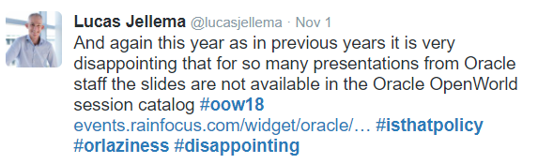

Slide 3
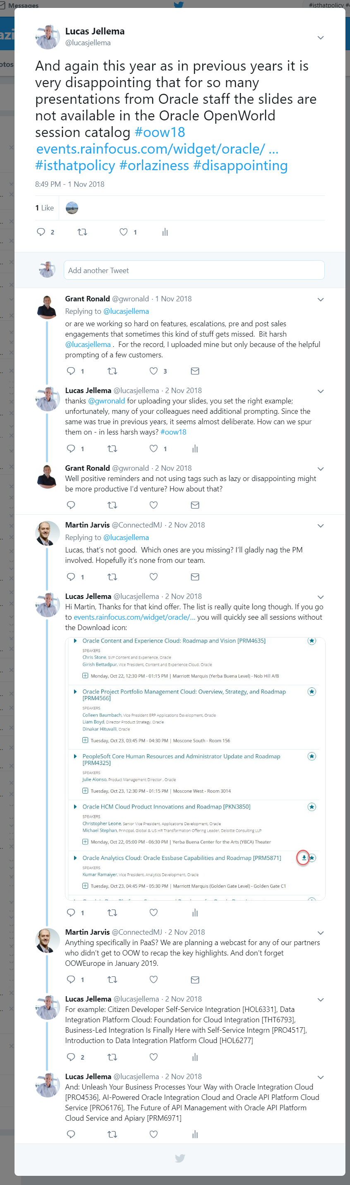

Slide 4
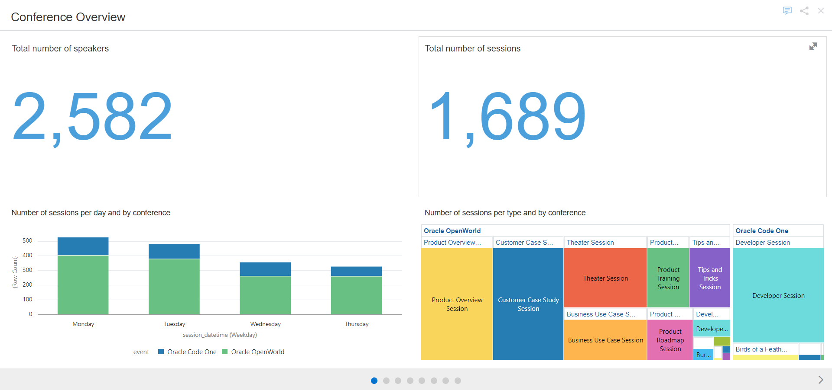
Overview of Oracle OpenWorld and CodeOne conferences

Slide 5
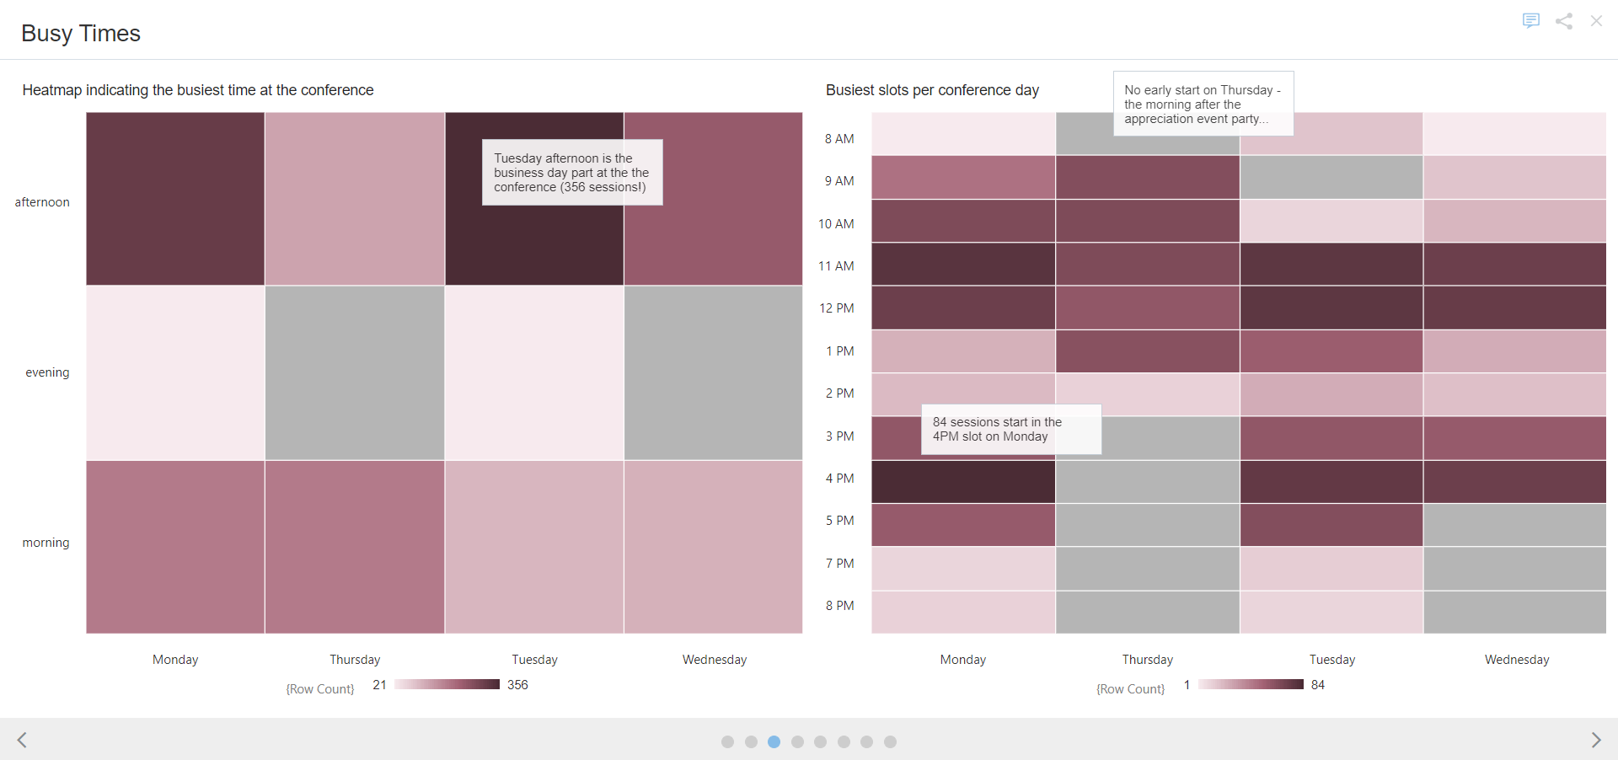
Heatmap with busy times during the conferences

Slide 6
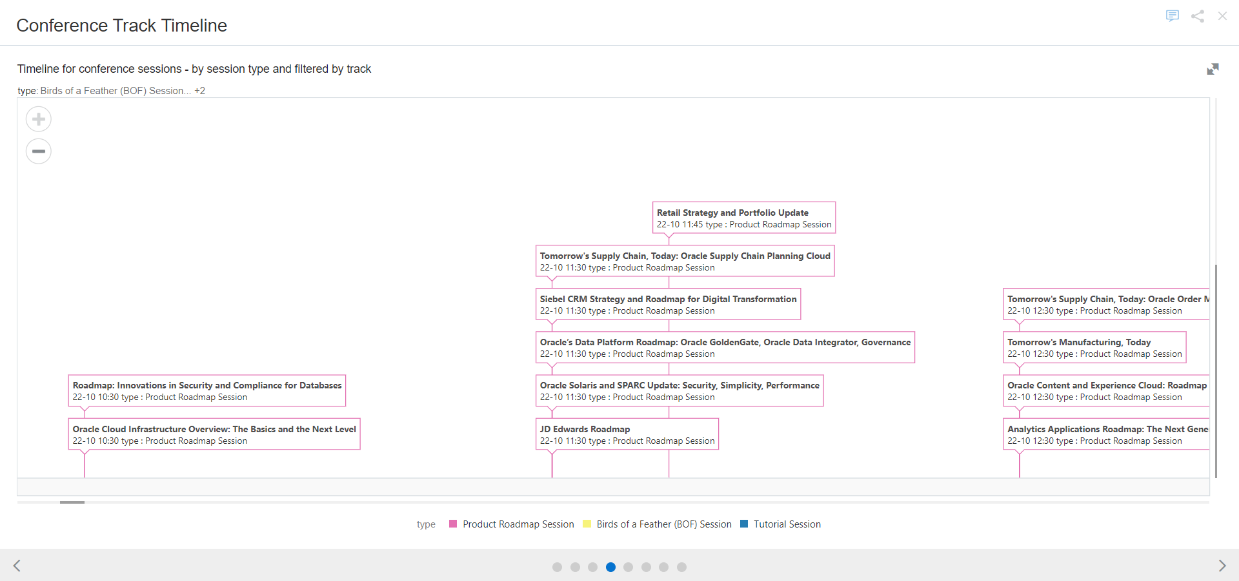
Timeline with conference sessions – filtered by three types of session types

Slide 7
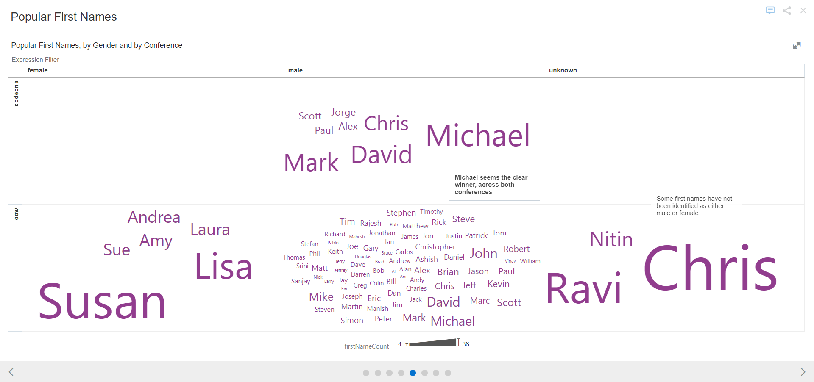
Exploring popular first names

Slide 8
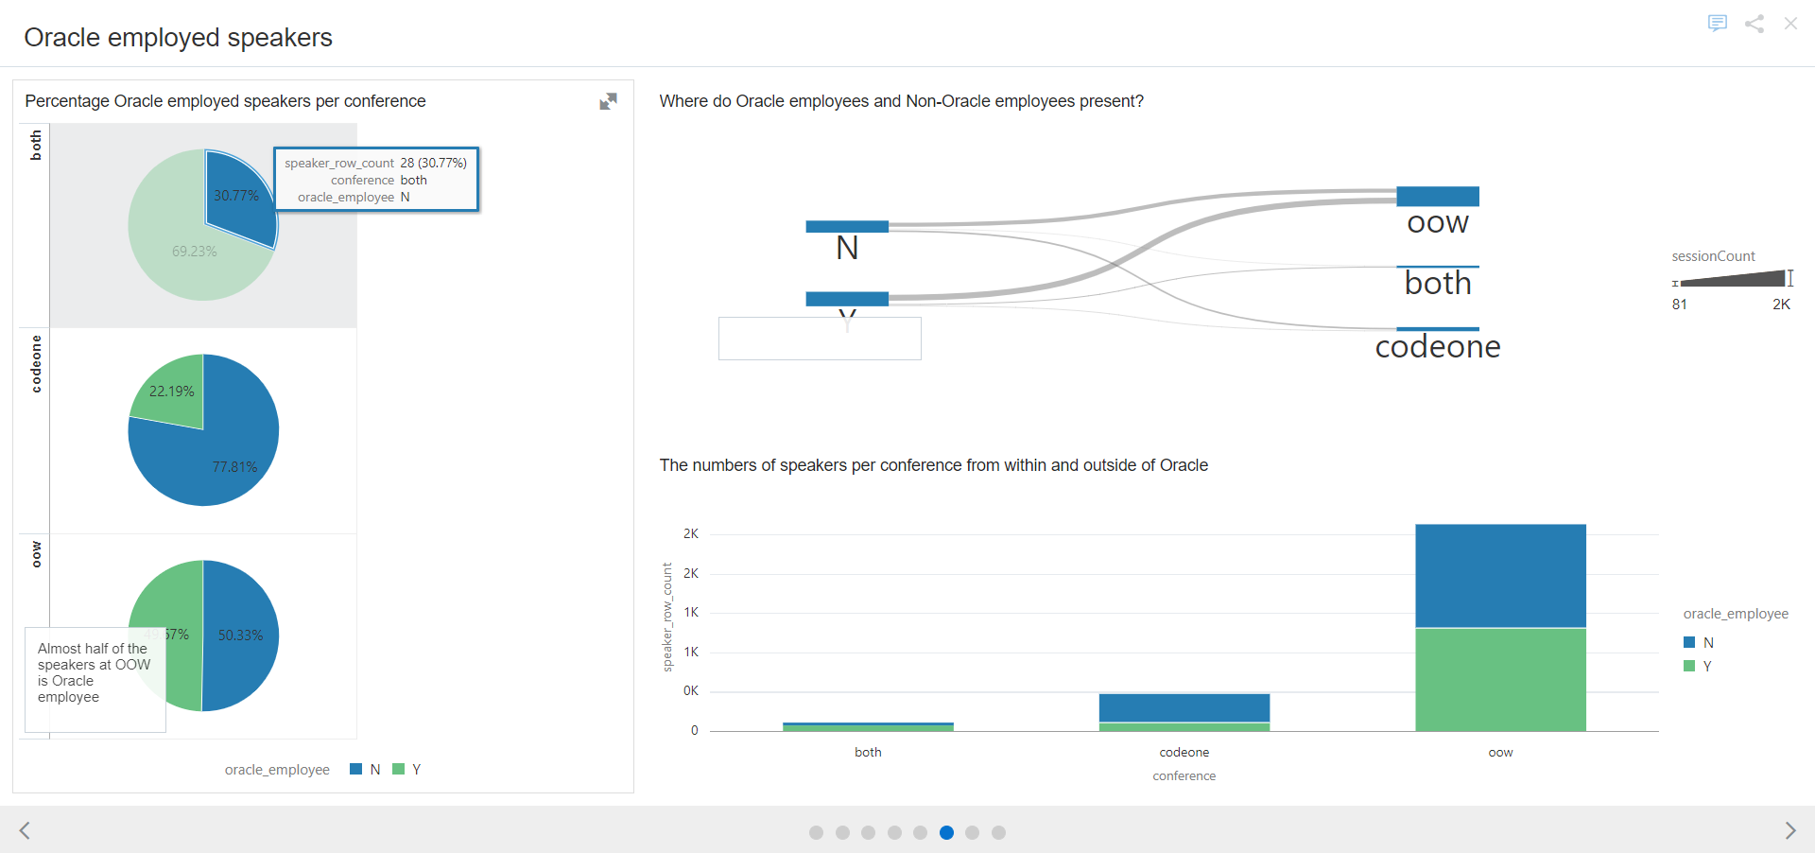
Overview of speakers employed by Oracle (or not)

Slide 9
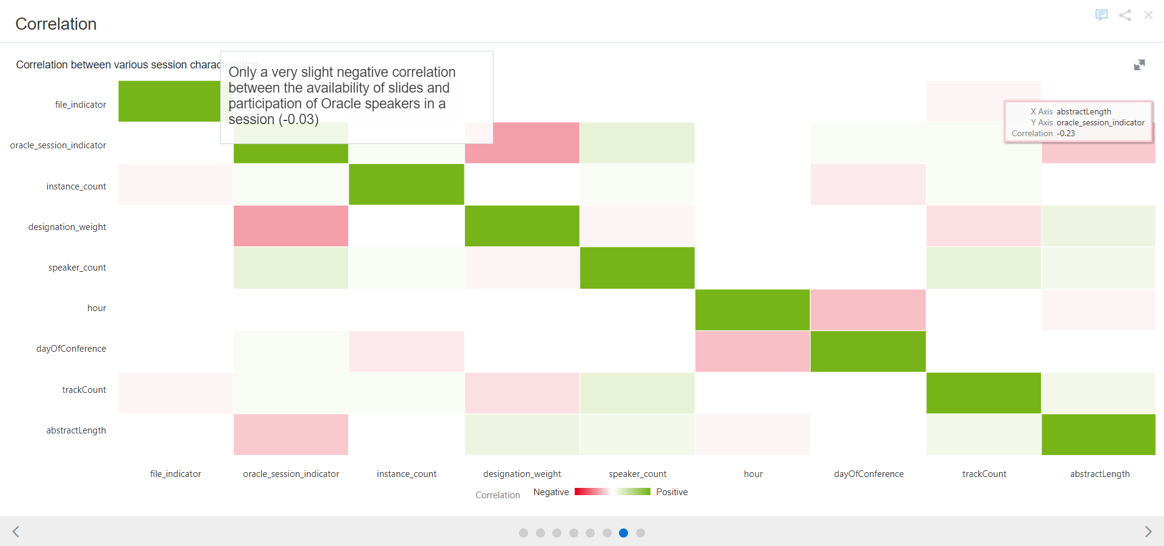
Correlation between various session attributes

Slide 10
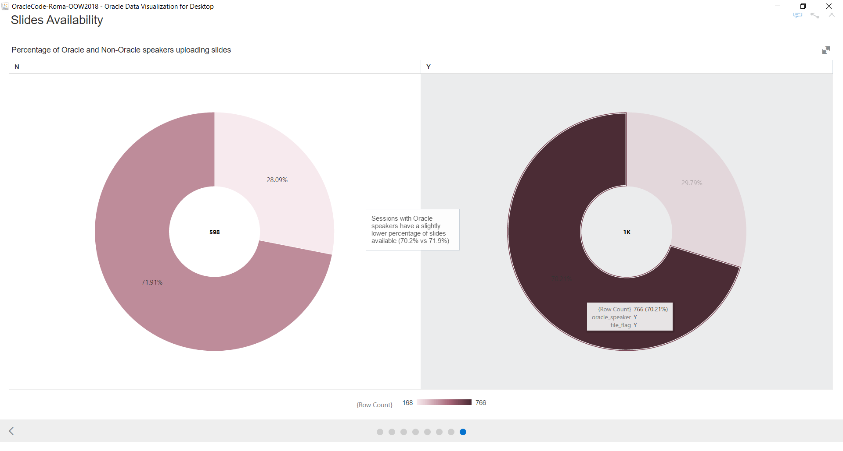
Do Oracle speakers do worse at making slides available?

Slide 11
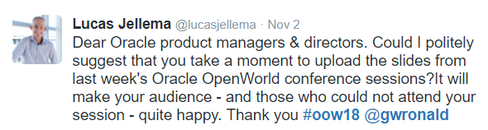

Slide 12
Overview
Objectives
What is Data Analytics
Classic: Enterprise Database
=> DWH => Reports, OLAP slice’n & dice’n, Dashboard, Visualization
What changed?
Number of sources & Types of data, volume and velocity,
Speed of business, Web scale Cloud, Machine Learning, Expectations
Data analytics pipeline
The process (how)
Data analytics pipeline
Technology (with what)
Oracle’s portfolio for data analytics
Demonstration of preparing data, creating visualizations and a narration

Slide 13


Slide 14

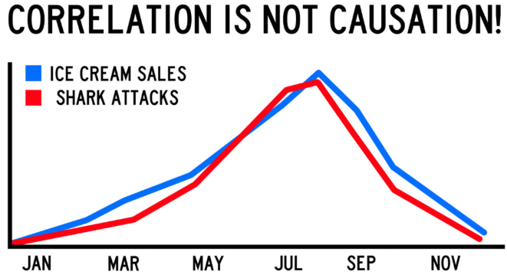
Value of data
Insight in state of affairs
Identifying trends
Knowledge of deviations and exceptions
Understanding of patterns, correlations, causes

Slide 15
Value of data
Insight in state of affairs
Identifying trends
Knowledge of deviations and exceptions
Visibility of patterns, correlations, causes
Consolidated from multiple, heterogeneous sources
Cleansed, validated, filtered, standardized, enriched
Interpreted and aggregated to a meaningful level
Presented in an interpretable form
Published and accessible at the right time via the optimal channel
Resulting in understanding, decisions, actions, predictions and recommendations
And a richer user experience – more efficient, effective and fun user interfaces

Slide 16
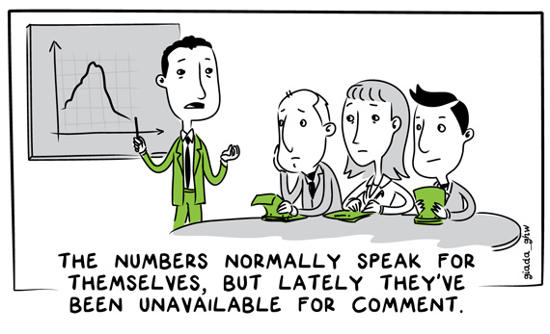
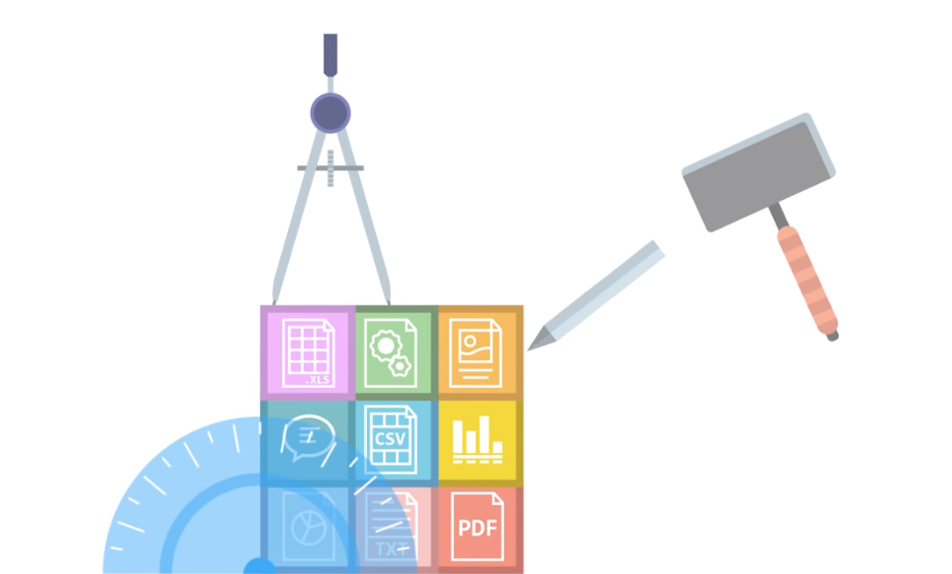
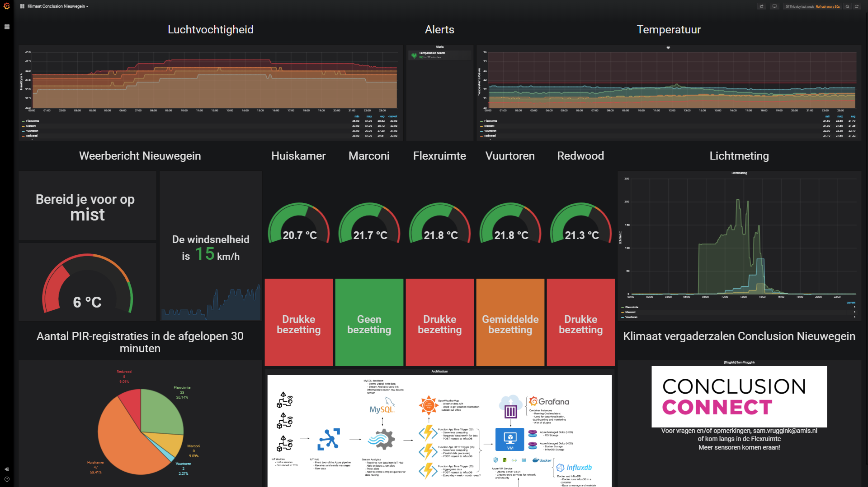
If you cannot measure what is important, you make what you can measure important
Notes:
Data.world
https://youtu.be/kdPkWDqks3g
Tot 0:58

Slide 17
What is new?
BI & OLAP Tools
Enterprise Database
(Oracle RDBMS)
Data Warehouse
(Oracle RDBMS)
ELT
ETL
Reporting engine
Data Mining
Materialized Views

Slide 18
What is new!
Types of Data and Data Sources
Volume of Data – Big!
Velocity of Data (and real time nature of requirements) – Fast!
(web) Scale and Speed of business
Open Data
Cloud
Machine Learning: has become feasible and accessible
Available
Affordable (software & hardware)
Doable (Citizen Data Scientist)
Fast enough
Expectations: Business Cases & Opportunities => Demands
End users, Consumers, Competitive pressure, Society (& Gartner)

Slide 19
Data Flow – from raw data to business insight & action
Machine Learning
Deploy & Leverage
Data Warehouse
Machine Learning Model
Raw/ Operational Data Sources
Data Pipeline
Data Wrangling
“Data Mart” single purpose data set
Data Lake
Business Intelligence
Dashboard, Notification & Alert Report, Visualization, Gamification, Data Explorer
3rd party data sources
Business insight: what, when, who and why
algorithms

Slide 20
Data Flow – from raw data to business insight & action
One time only
Periodic, in batch
Continuous, event triggered
Machine Learning
Deploy & Leverage
Data Warehouse
Machine Learning Model
Raw/ Operational Data Sources
Data Pipeline
Data Wrangling
“Data Mart” single purpose data set
Data Lake
Business Intelligence
Dashboard, Notification & Alert Report, Visualization, Gamification, Data Explorer
3rd party data sources
Business insight: what, when, who and why
algorithms
Master Data Management, Meta-Data Management, Data Governance
Data Access, Authorization, Privacy
Notes:
Iteratief – keer terug naar voorgaande stap om meer data, andere wrangling

Slide 21
Data Flow – from raw data to business insight & action
ETL/ELT, Change Data Capture, Event Bus/Message Queue, file/ftp handlers, adapters, ESB, Web Scraping, Streaming (event) Analytics …
Relationele Database
NoSQL Database (Document Store, Key/Value Store, GraphDB, Time Series, ..)
Hadoop
Event Store
Object Store, Block Store
Data Warehouse
Raw/ Operational Data Sources
Data Pipeline
Data Lake
Standard Business Applications & SaaS (SAP, Oracle EBS, Siebel, SalesForce, AFAS, Dynamics)
Custom applications
Fast Sources: IoT, Web Clicks, Social Media, Events
Unstructured: image/video, log-files, text/CMS, email
…

Slide 22
Data Flow – from raw data to business insight & action
Data Warehouse
Raw/ Operational Data Sources
Data Pipeline
Data Wrangling
“Data Mart” single purpose data set
Data Lake
3rd party data sources
algorithms
Turn Data into Business Value - Starting with Data Analytics on Oracle Cloud

Slide 23
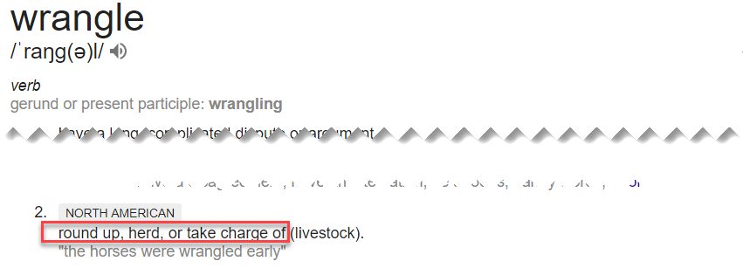
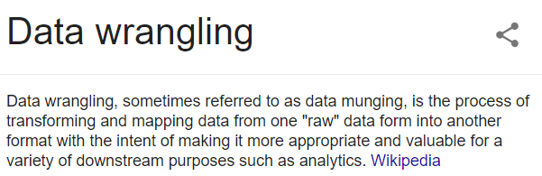
Data Wrangling

Slide 24
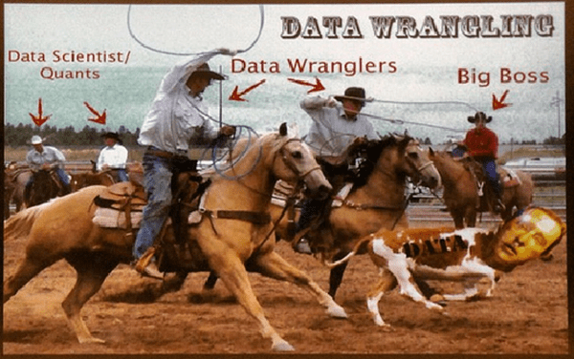

Slide 25
Data Flow – from raw data to business insight & action
Discover,visualize, describe
Extract, parse,interpret
Cleanse & Validate
Filter, Deduplicate, Denormalize
Unify (units, language, spelling, coding)
Convert & Transform
Anonymize, Obfuscate/Redact
Enrich
Join, Aggregate
Feature engineering
Relational Database
NoSQL Database
Hadoop
Object Store
Data Warehouse
Raw/ Operational Data Sources
Data Pipeline
Data Wrangling
“Data Mart” single purpose data set
Data Lake
OCR
Speech to Text
Sentiment Analysis
Gist / Topics extraction
Image recognition
Translation
Spelling correction
Anomaly detection
Classification
Principal Component Analysis
3rd party data sources
Open Data APIs (governments, NGOs, companies)
Social Media
Kaggle, data.world
DaaS-vendors
algorithms
Turn Data into Business Value - Starting with Data Analytics on Oracle Cloud
Notes:
https://help.data.world/hc/en-us/articles/360006491854-What-does-data-world-do- - video?

Slide 26
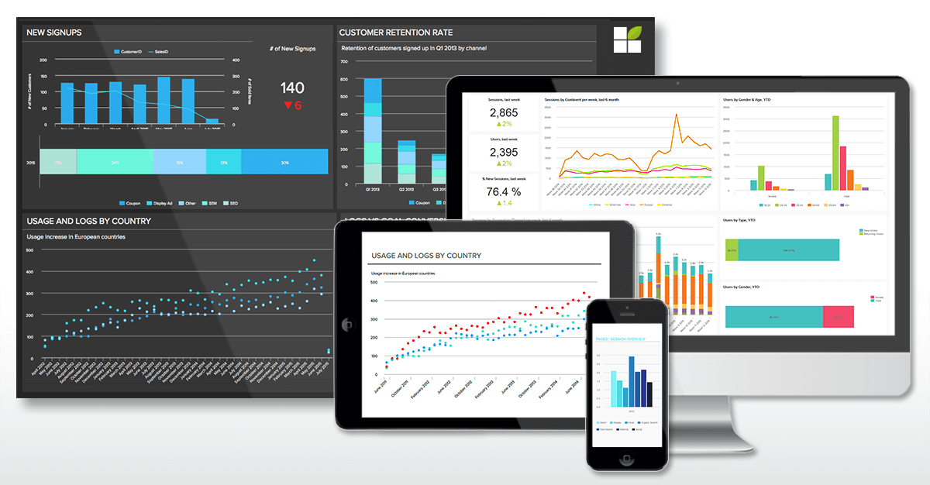
Data Flow – from raw data to business insight & action
Design Visualization, Report, Dashboard, Notification, Animation, self-service data discovery & exploration
Multi-channel, pull/push, distribute
Implement| Test | Roll Out | Operate
Enforce Data Authorization
Data Warehouse
Raw/ Operational Data Sources
Data Pipeline
Data Wrangling
“Data Mart” single purpose data set
Data Lake
Business Intelligence
Dashboard, Notification & Alert Report, Visualization, Gamification, Data Explorer
3rd party data sources
Business insight: what, when, who and why
algorithms
Turn Data into Business Value - Starting with Data Analytics on Oracle Cloud

Slide 27
Data Flow – from raw data to business insight & action
Machine Learning
Deploy & Leverage
Data Warehouse
Machine Learning Model
Raw/ Operational Data Sources
Data Pipeline
Data Wrangling
“Data Mart” single purpose data set
Data Lake
Business Intelligence
Dashboard, Notification & Alert Report, Visualization, Gamification, Data Explorer
3rd party data sources
Business insight: what, when, who and why
algorithms
Turn Data into Business Value - Starting with Data Analytics on Oracle Cloud

Slide 28
Levels of AI/Machine Learning
Generic, Out of the box, ready to use (AI Services)
OCR, Image & Video Recognition, Sentiment Analysis, Speech to Text, Text Gist/Summary, Text to Speech
Guided training using your own data of a predefined ML model for specific use cases
IoT Predictive Analytics, Forecast, Recommendation, ChatBot, Cloud Talent
Do it (largely) yourself ML
Train your own model on your own data set using frameworks, libraries and raw technologies

Slide 29
Data Flow – from raw data to business insight & action
Select algorithm
Configure model
Train model with training data
Test Model
… iterate ….
Accept/Select Model
Machine Learning
Deploy & Leverage
Data Warehouse
Machine Learning Model
Raw/ Operational Data Sources
Data Pipeline
Data Wrangling
“Data Mart” single purpose data set
Data Lake
Business Intelligence
Dashboard, Notification & Alert Report, Visualization, Gamification, Data Explorer
3rd party data sources
Business insight: what, when, who and why
algorithms
Turn Data into Business Value - Starting with Data Analytics on Oracle Cloud

Slide 30


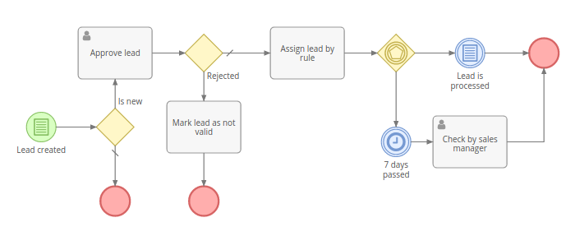
Leveraging Machine Learning models
Application
API
Machine Learning
Deploy & Leverage
ML Model
Machine Learning Model
“Data Mart” single purpose data set
Data Wrangling
algorithms

Slide 31
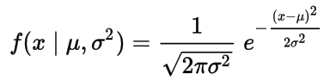
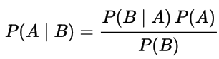
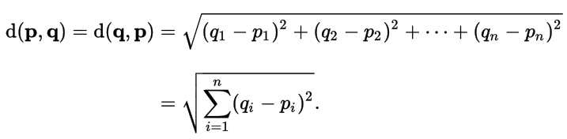
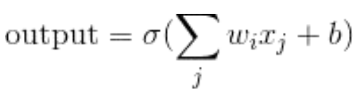
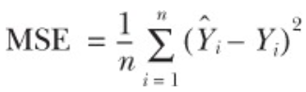
What to do it with?
Mathematics (Statistics)
Gauss (normal distribution)
Bayes’ Theorem
Euclidean Distance
Perceptron
Mean Square Error

Slide 32
[examples of] Technologie in Data Flow
Python, R, Apache Spark, SQL & PL/SQL
Jupyter Notebooks, Apache Zeppelin
NumPy, SciPy, SciKit-learn, Pandas, Bokeh, Plotly, Matplotlib, NLTK, Keras, TensorFlow, PyTorch, MXNet, Caffe, Theano
Oracle Analytics Cloud, Oracle Data Science Platform, Oracle Autonomous Datawarehouse Cloud
AutoKeras AWS SageMaker, Google AI Platform, Google AutoML, Azure Machine Learning Studio
Azure Cognitive Services, AWS AI
Oracle Autonomous Datawarehouse Cloud, AWS RedShift, Google BigData, Azure SQL Data Warehouse, Azure Data Lake Store, Oracle Database
Azure Cosmos DB, Elastic Stack, MongoDB,InfluxDB, Cassandra, AWS DynamoDB, Excel
Hadoop, Kafka, Oracle BigData Cloud
AWS S3, Oracle Storage, OneDrive, Google Storage
Machine Learning
Deploy & Leverage
Data Warehouse
Machine Learning Model
Raw/ Operational Data Sources
Data Pipeline
Data Wrangling
“Data Mart” single purpose data set
Data Lake
Business Intelligence
Dashboard, Notification & Alert Report, Visualization, Gamification, Data Explorer
3rd party data sources
Business insight: what, when, who and why
Jupyter Notebooks, Python, Apache Spark, Java, R, Apache Zeppelin
SQL & PL/SQL, SQL Developer
SPARQL Oracle Analytics Cloud, Oracle Big Data SQL
Google Cloud DataPrep, Azure Wrangler (Trifacta Wrangler) , Google BigQuery
Excel, csvkit, Pentaho
SQL, Java, Python, Node JS
SQL Developer, Apache Spark, Drill, Flink
Oracle Data Integration Platform Cloud, Oracle Integration Cloud & Cloud Adapters
Kafka, Connectors, KSQL & Streams Debezium
Azure EventHubs
AWS Lambda, SQS, SNS, Glue, Kinesis, Step Functions
algorithms
d3.js, React D3, SVG
Oracle Analytics Cloud, Oracle Visual Builder, Excel, SQL Developer, Oracle APEX
Pentaho, OpenStreetMap
Azure PowerBI, AWS QuickSight
Tableau, Qlik, Looker,
SAP Analytics (Business Objects), IBM Cognos, SAS, Tibco JasperSoft
Kibana, Grafana
Turn Data into Business Value - Starting with Data Analytics on Oracle Cloud

Slide 33
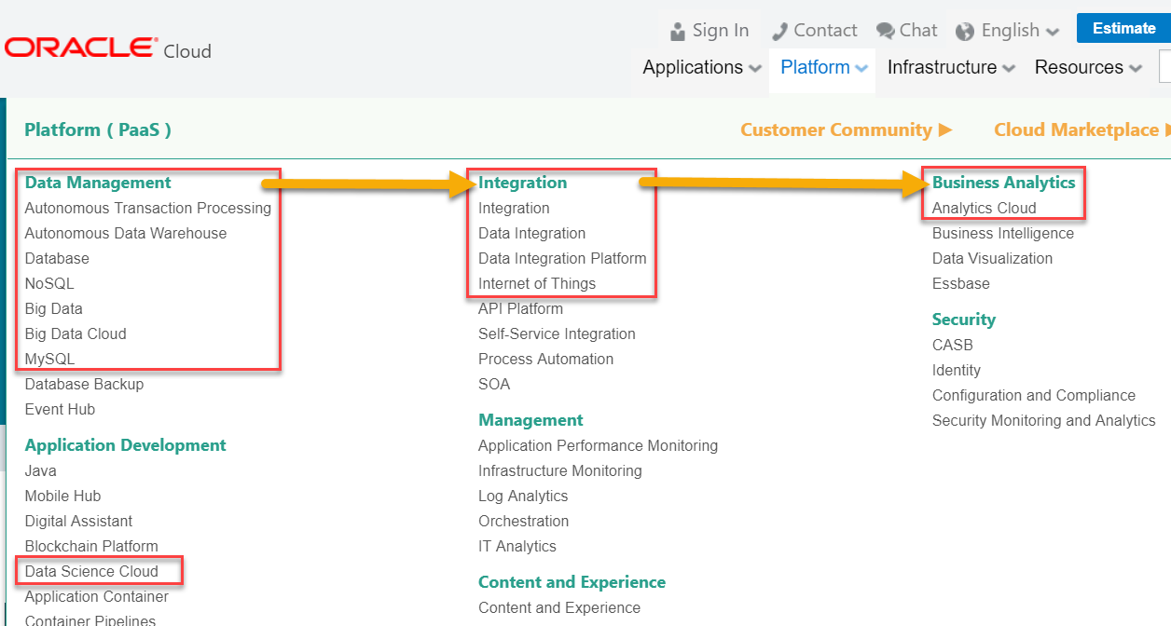
From Data to Actionable Intelligence

Slide 34


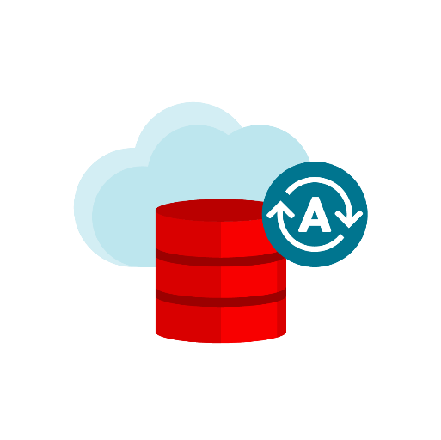





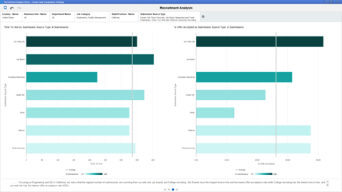






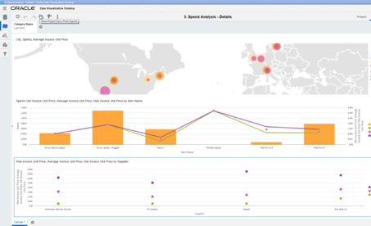


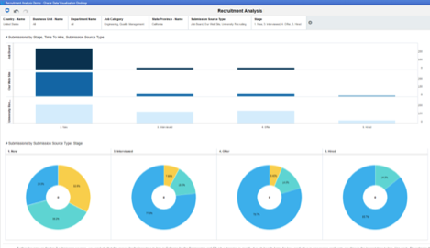



Scale your Analytics!
Autonomous
Data Warehouse Cloud
Data Integration
Platform Cloud
Oracle
Analytics Cloud
Big Data Cloud

Slide 35
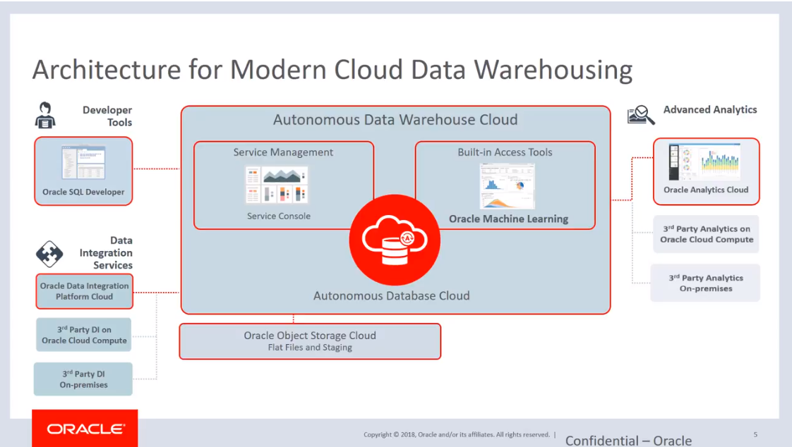
But wait – there is more… Autonomous Data Warehouse [Cloud]

Slide 36
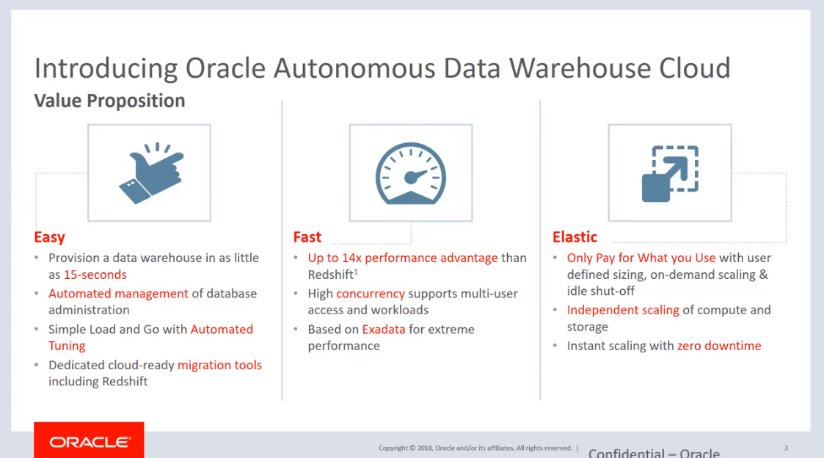

Slide 37
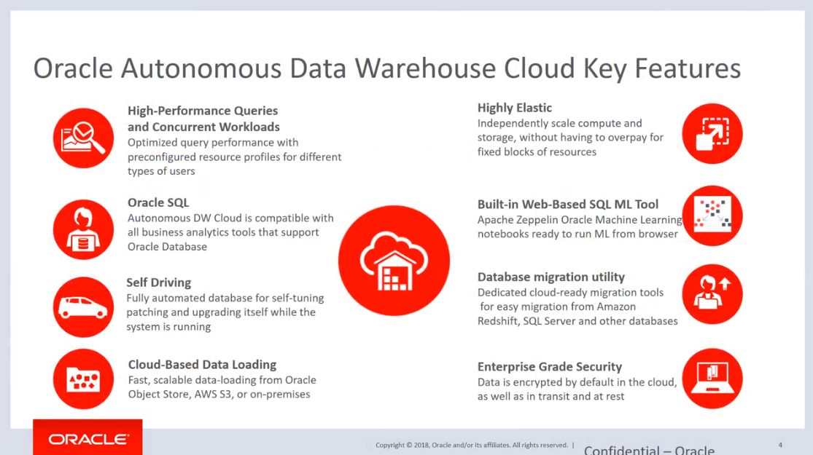

Slide 38
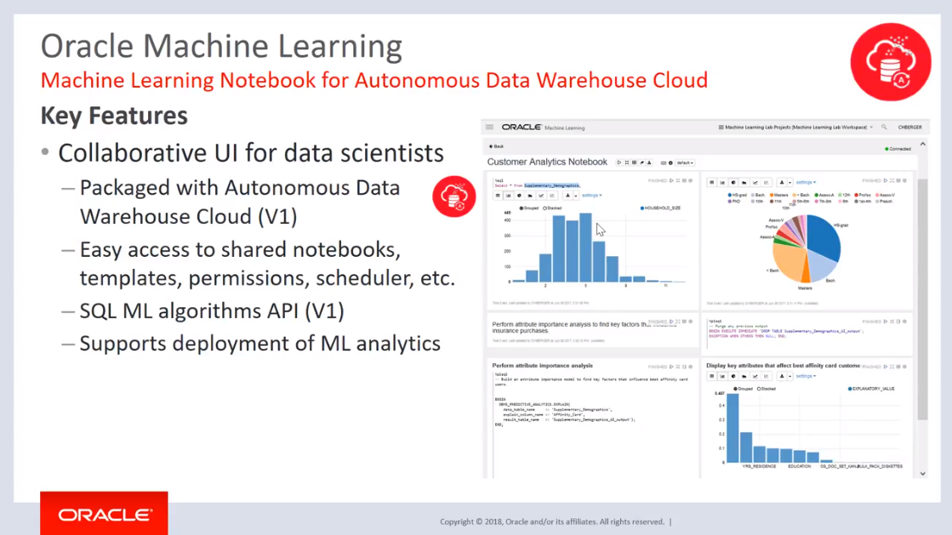

Slide 39
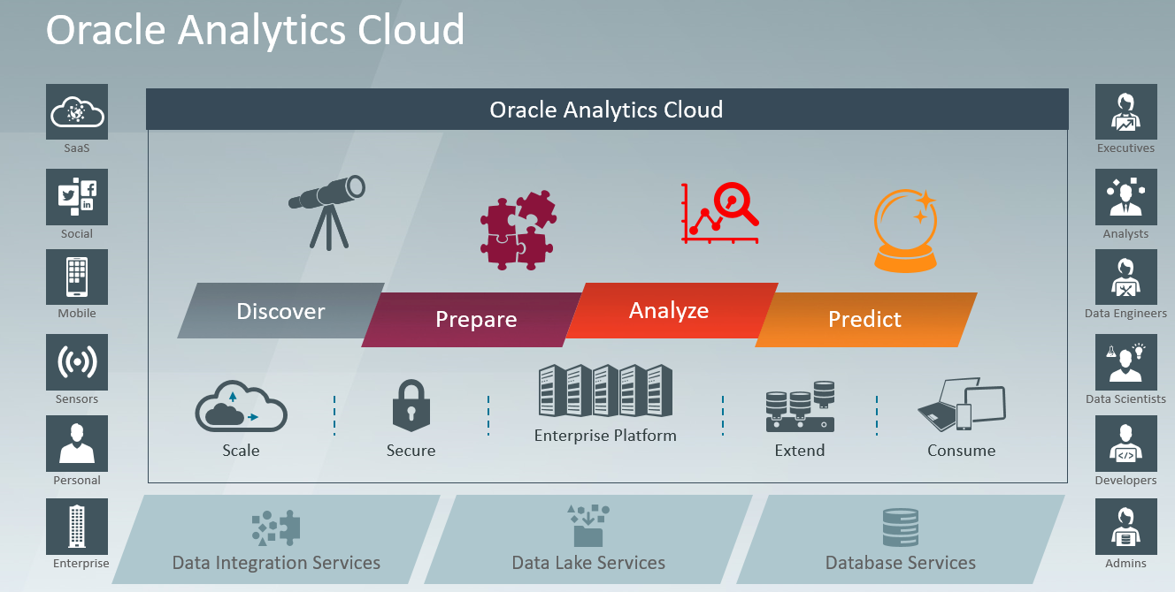

Slide 40
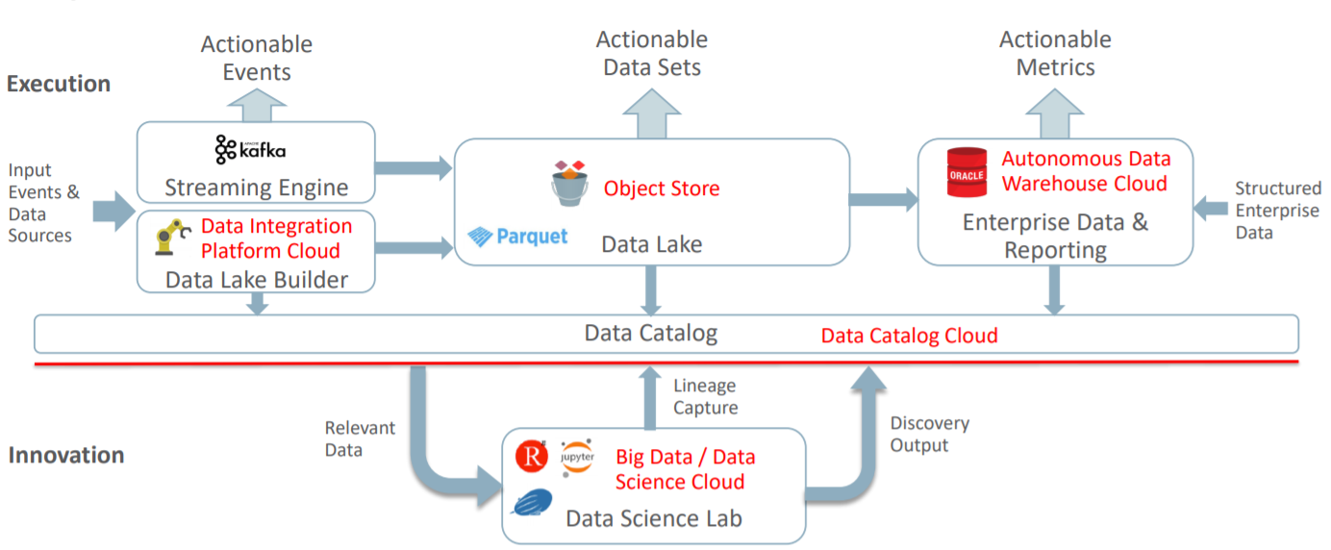
Reference Architecture for Data Driven organizations
Analytics
Cloud
OLTP
IoT
Social

Slide 41
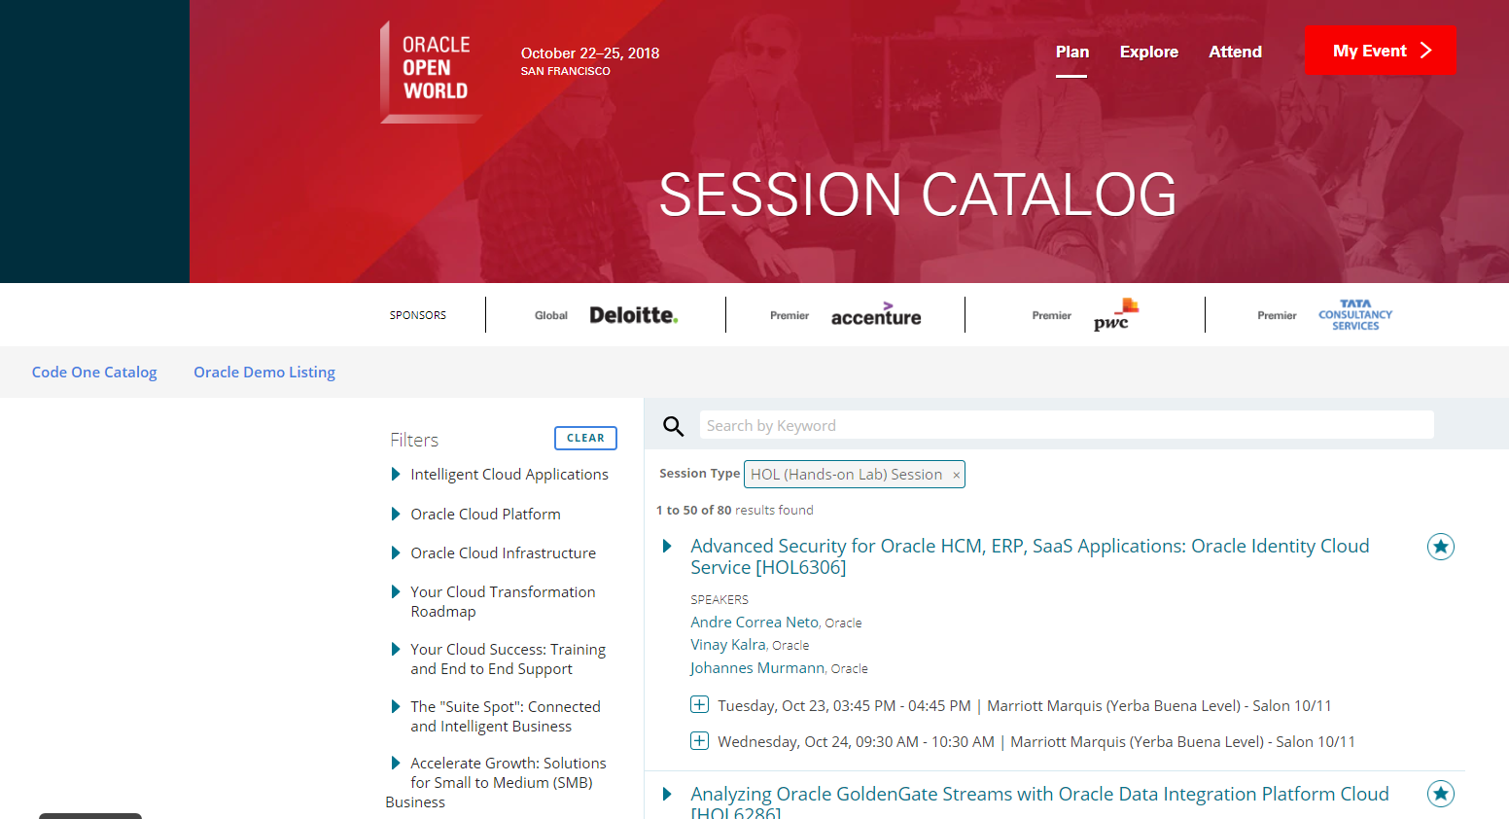


Data Analytics on Oracle OpenWorld 2018 Session Details

Slide 42
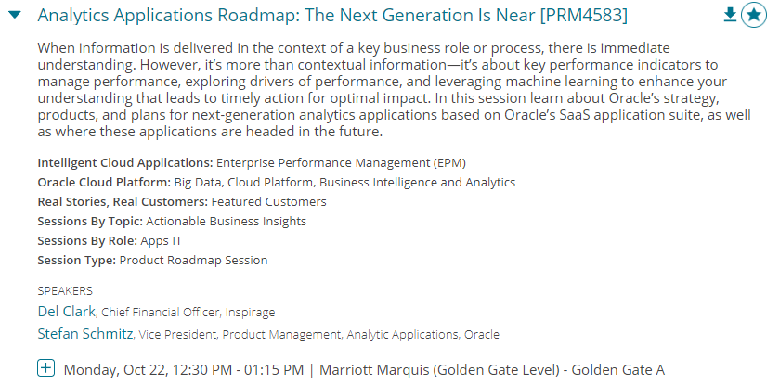
High level overview
Details per session:

Slide 43
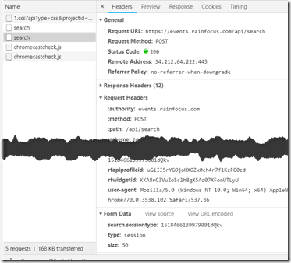
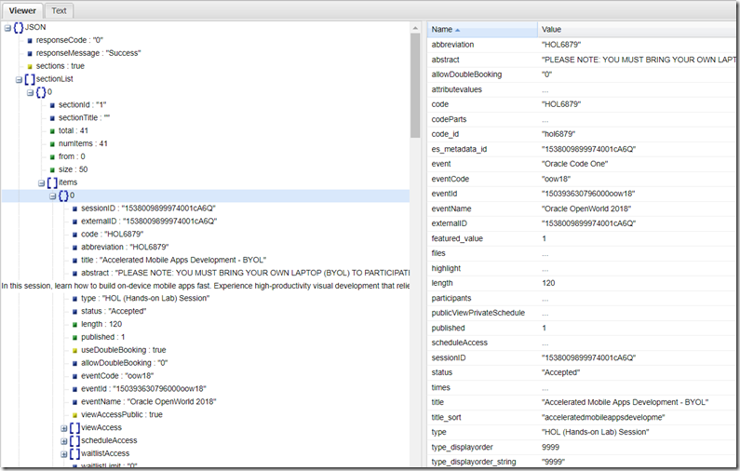
Session Catalog – REST API – returning data in JSON format

Slide 44

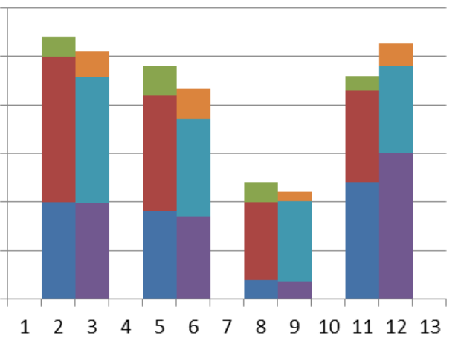

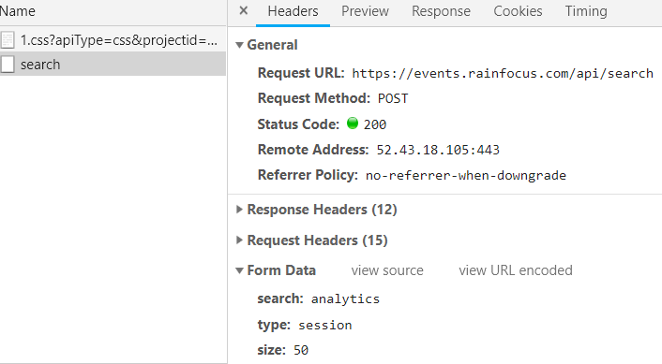
Flow for Oracle OpenWorld 2018 Session Data Analytics
Data Gathering
Data Wrangling
Business Intelligence
Report & Visualization on Speakers
API for session details in JSON
Report & Visualization on Sessions
Machine Learning
AMIS Kick Off 2019 - Proposities & Data Analytics

Slide 45
Flow for Oracle OpenWorld 2018 Session Data Analytics
Oracle Autonomous Datawarehouse Cloud, local file system
Python & Jupyter Notebook
Oracle Analytics Cloud
Data Gathering
Data Wrangling
Business Intelligence
Report & Visualization on Speakers
API for session details in JSON
Oracle Analytics Cloud
Report & Visualization on Sessions
Machine Learning
AMIS Kick Off 2019 - Proposities & Data Analytics
Oracle Analytics Cloud

Slide 46
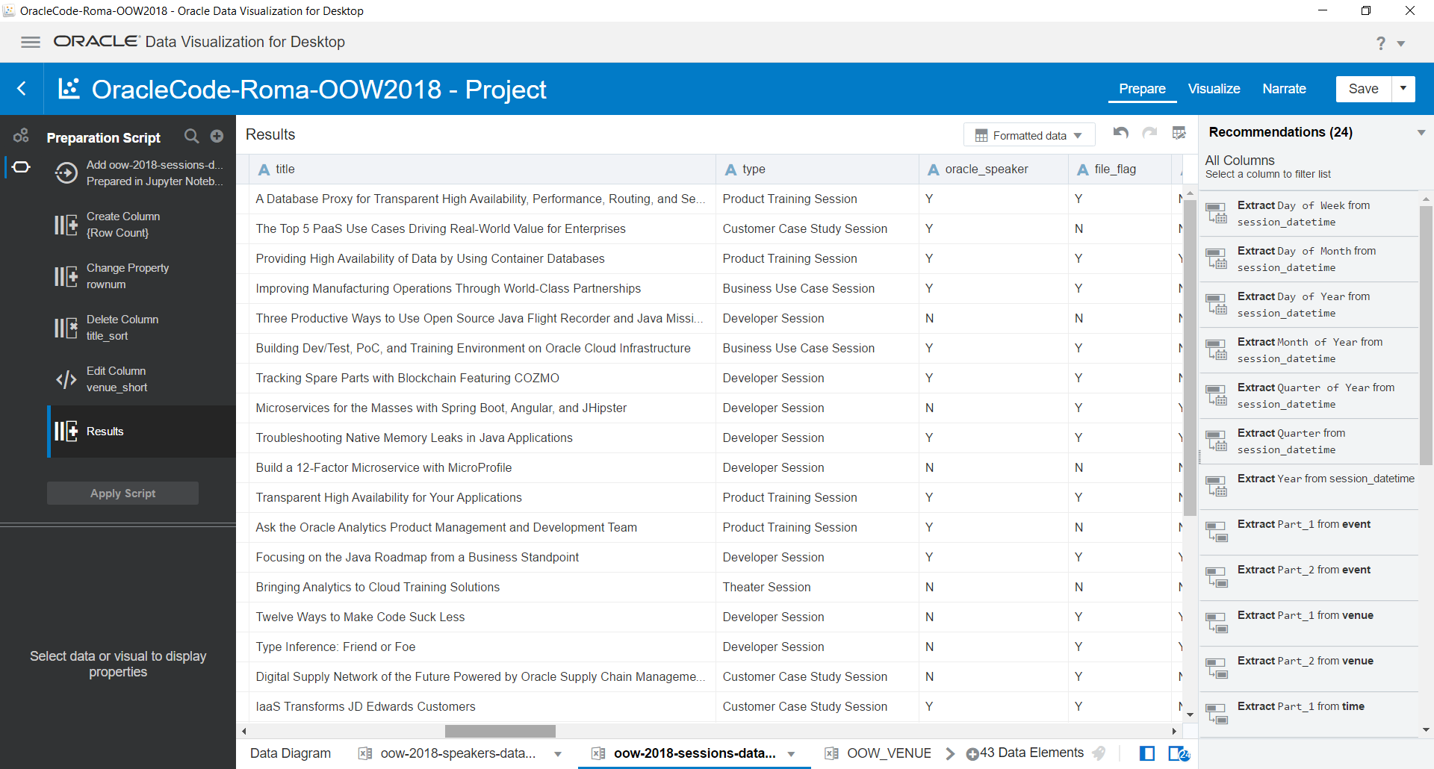
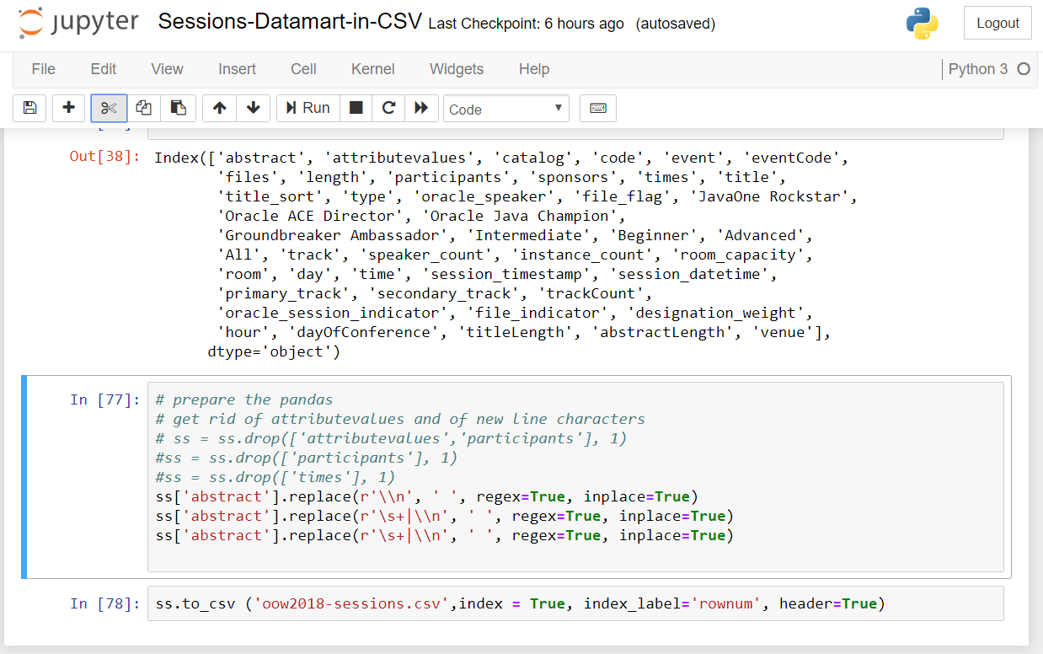
Implementation details of Flow for Oracle OpenWorld 2018 Session Data Analytics
Data Visualization for Desktop to prepare Data Sets
Jupyter Python Notebook – retrieve raw JSON data from APIs
Save Sessions and Speakers data in CSV files

Slide 47
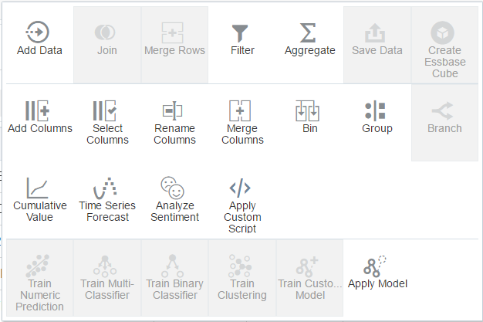
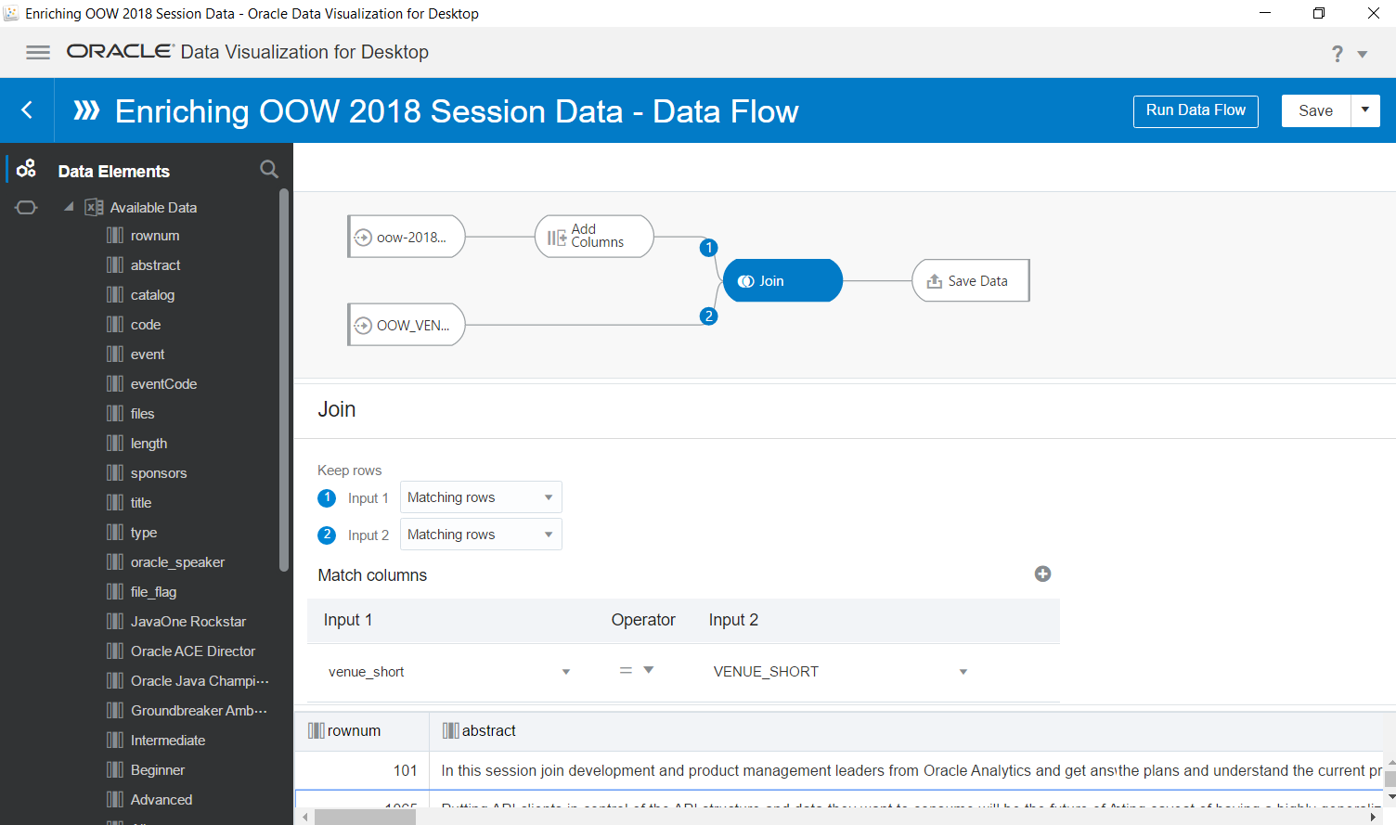
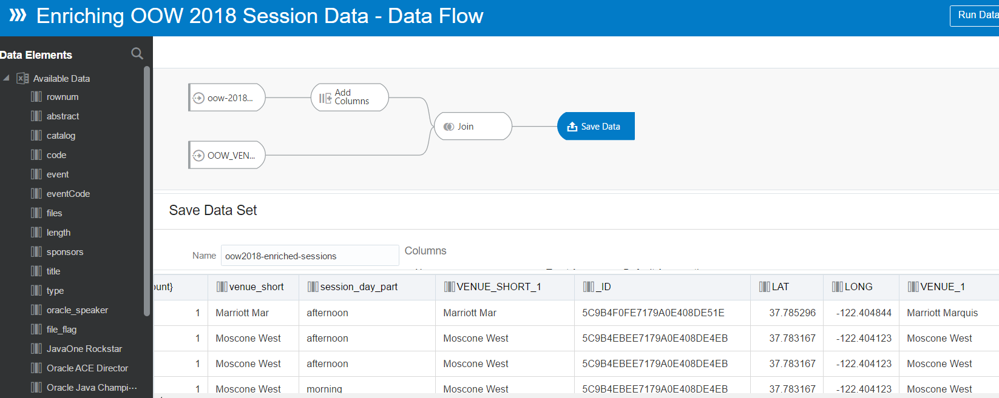
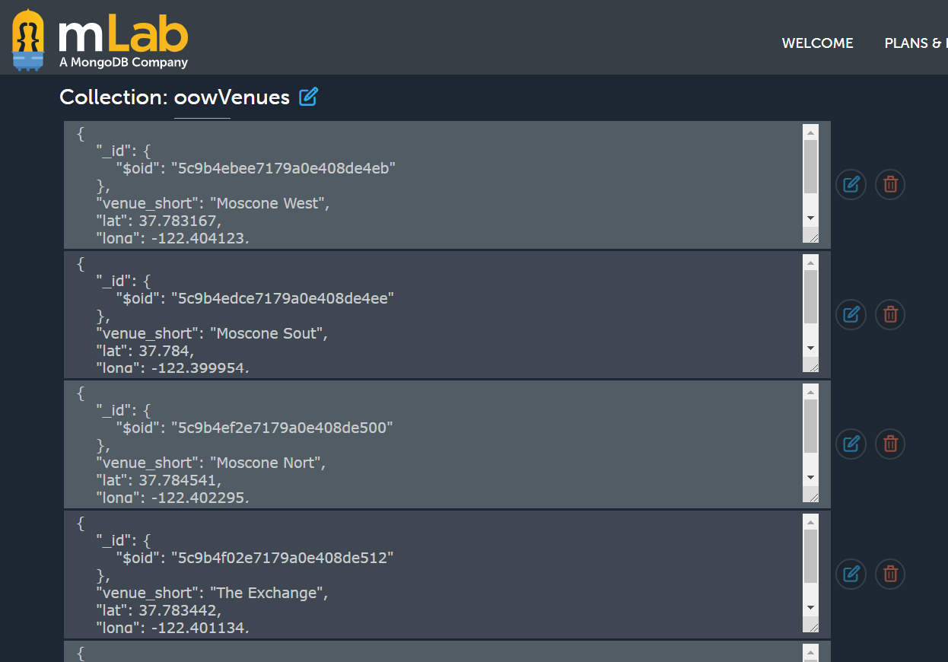
Implementation details of Flow for Oracle OpenWorld 2018 Session Data Analytics
Dataflows can be used to train and apply machine learning models
Data Visualization –
Dataflow for enriching and joining data sets
Sessions are joined with Venues from a cloud based MongoDB database

Slide 48
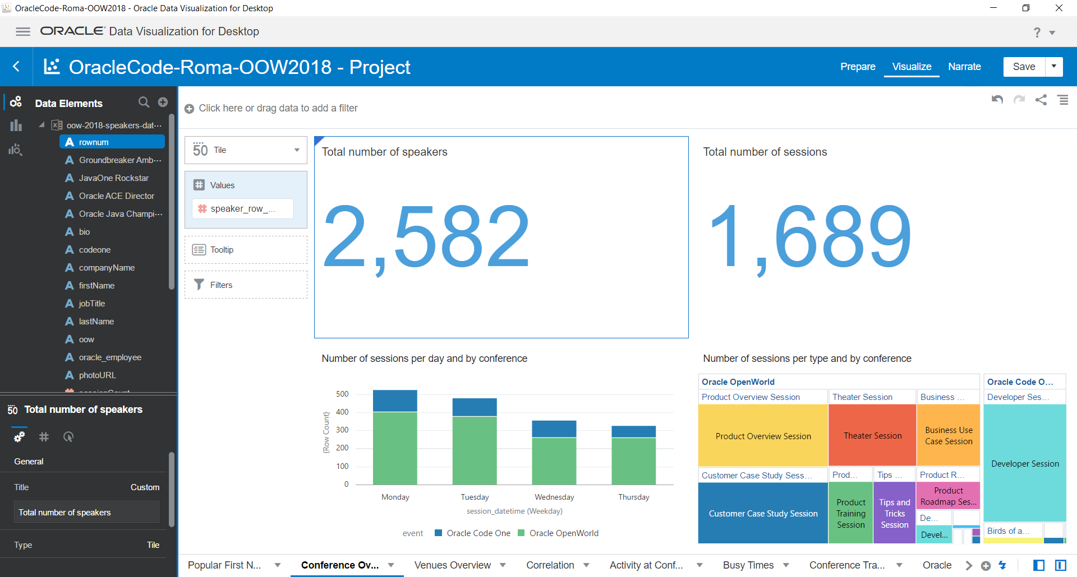
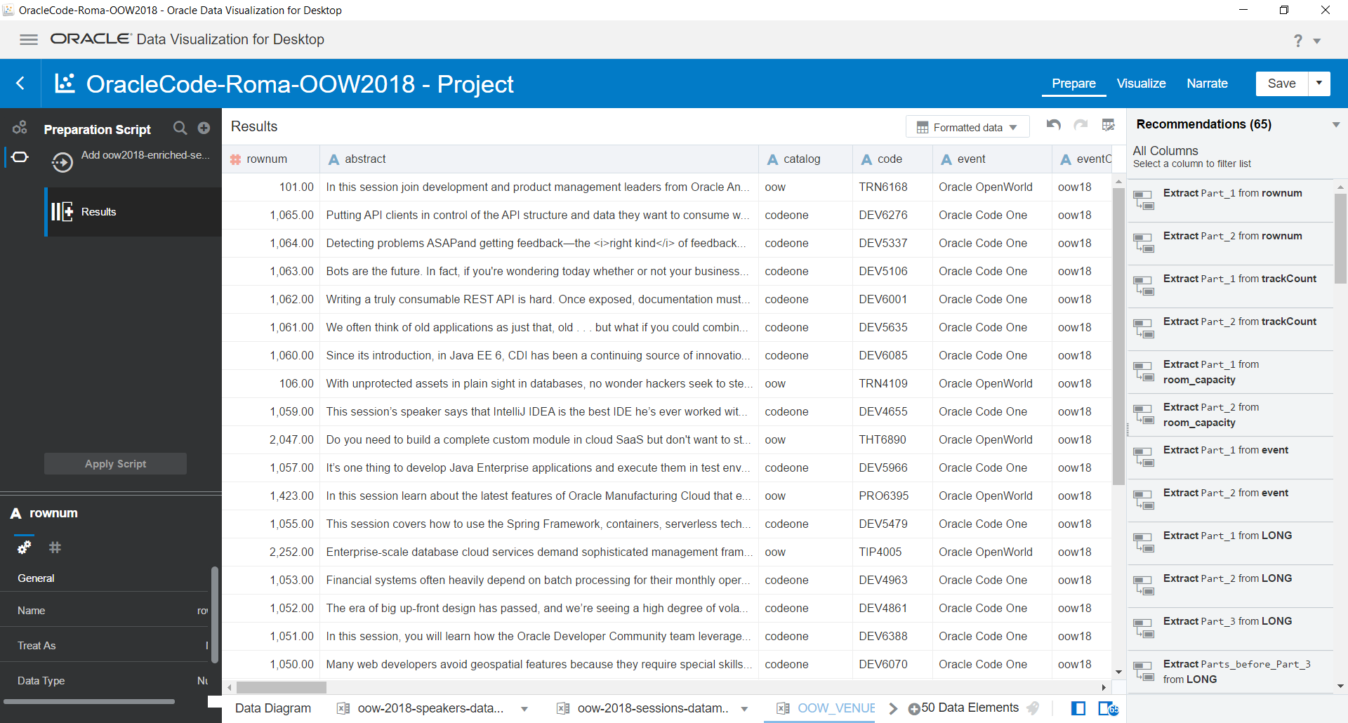
Implementation details of Flow for Oracle OpenWorld 2018 Session Data Analytics
Prepare visualizations from the enriched data sets
Define Data Actions to add interactivity to the Visualizations
Choose one of dozens of visualization types, configure dimensions, filters, colors, titles, …

Slide 49
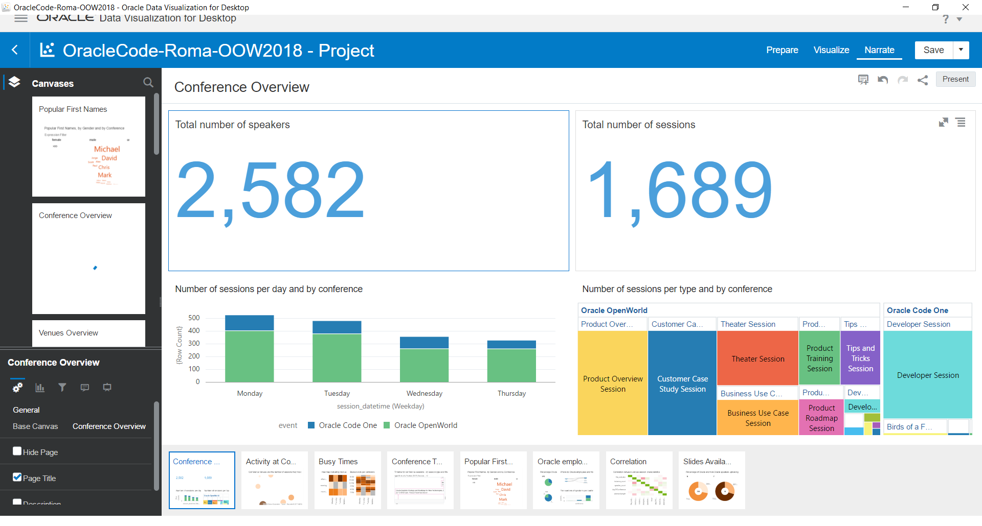
Implementation details of Flow for Oracle OpenWorld 2018 Session Data Analytics
Prepare Narrative using selected Canvases combined with annotations

Slide 50
Implementation details of Flow for Oracle OpenWorld 2018 Session Data Analytics
Present and Share Narrative

Slide 51

Oracle Data Visualization Desktop – The Cloud has Landed
Desktop tool
Optional: integrates with Excel
On par functionality with Analytics Cloud
Single User
Limited physical resources
Free!?

Slide 52






Summary
Data contains great value – for understanding, improving, predicting, preventing, learning how to automatically process
A rigorous process is required to extract value from data
Gathering data
Preparing data – discovering, wrangling, enriching, …
Training, Testing and Productizing Machine Learning models
Visualizing data – explore and present and share
Oracle’s Data Analytics portfolio supports this process quite well
Autonomous Warehouse Cloud & Essbase Cloud
BigData Cloud
Analytics Cloud
Data Visualization Desktop
Data Science Platform

Slide 53




Contact Details
Blog: technology.amis.nl
Email: lucas.jellema@amis.nl
: lucasjellema
: lucas-jellema
: www.amis.nl, info@amis.nl +31 306016000 Edisonbaan 15, Nieuwegein

